Slide 1
Second-hand Car Price Prediction
By: Marcus Chan

Slide 2
Problem Definition
India is a growing Market
India has a growing demand in cars
Progression
Indian Markets slowly become saturated
Indian second-hand car markets grow larger
Pricing is unknown for second hand models

Slide 3
Key Questions
?
?
What factors contribute to overall pricing
What kind of model would provide most accurate predictions
How might the data be handled
How can the found model be implemented
?

Slide 4
Data Set
Data collected come from 1998 to 2019
Below are the column values of the Dataset
Owner: Type of ownership
Mileage: The standard mileage offered by the car company in KMPL or KM/KG
Engine: The displacement volume of the engine in CC
Power: The maximum power of the
engine in BHP
Seats: The number of seats in the car
New_Price: The price of a new car of the same model in INR 100,000
Price: The price of the used car in INR 100,000
Name: Name of the car which includes Brand name and Model name
Location: The location in which the car is being sold or is available for purchase (Cities)
Year: Manufacturing year of the car
Kilometers_driven: The total kilometers driven in the car by the previous owner(s) in KM
Fuel_Type: The type of fuel used by the car (Petrol, Diesel, Electric, CNG, LPG)
Transmission: The type of transmission used by the car (Automatic / Manual)

Slide 5
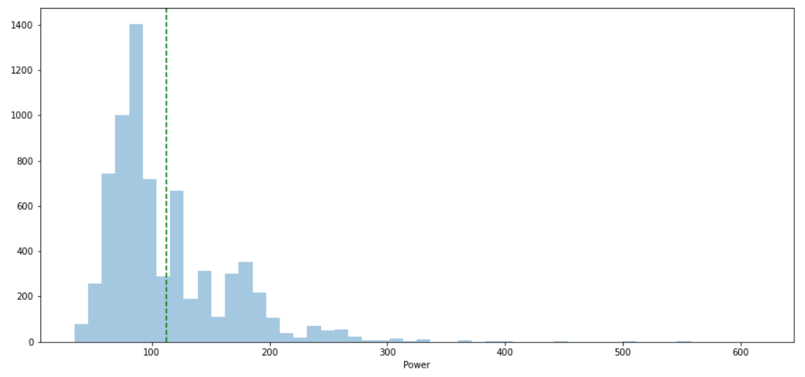
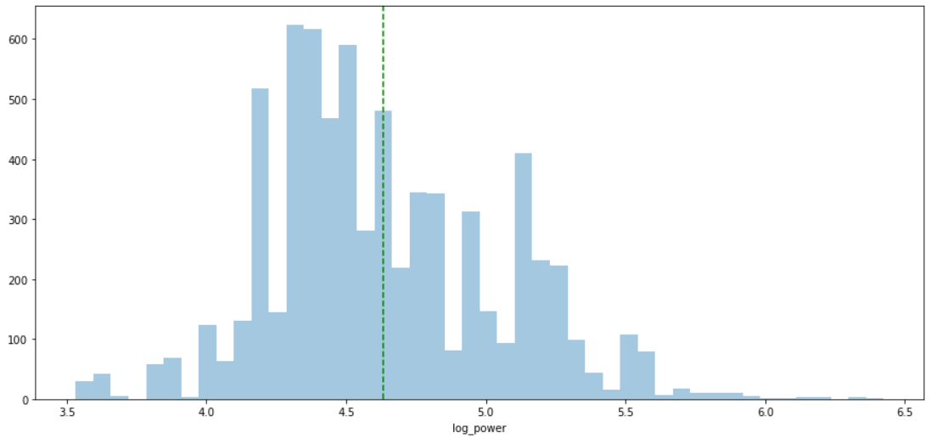
Solution Process
Preprocessing:
Remove Multicollinearity
Scaled Data
Remove Overlapping Elements
VIF scores
Skewed Data
Log values
Missing Values
Matching and Imputing
Significant Variables
Derivative variables
Power
Logged
Power

Slide 6
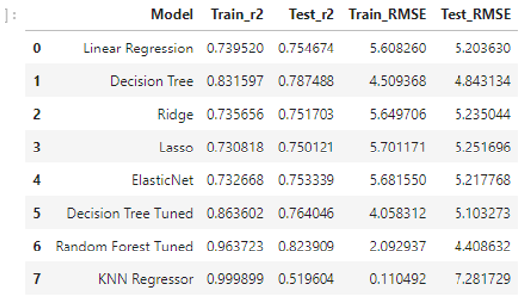
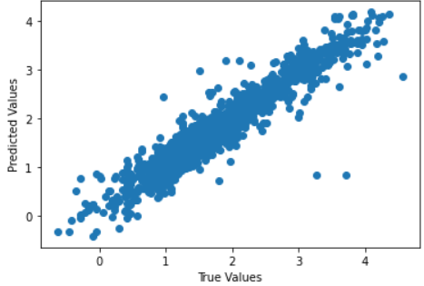
Proposed Models
Models
Linear Regression
Ridge
Lasso
Decision Tree
Random Forest
ElasticNet
KNN
Random Forest
Regression Results

Slide 7
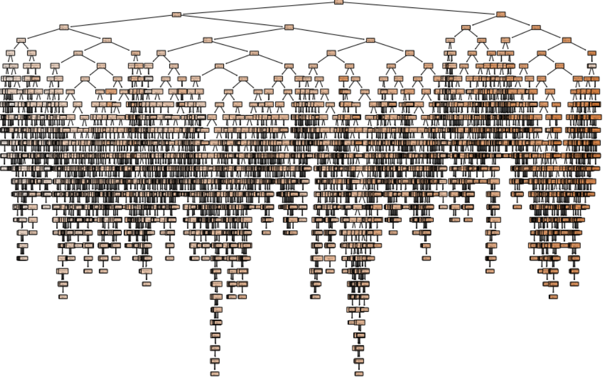
Finalizing Model
Random Forest Decision Tree
Overall most accurate predictions
Robust over modified data sets
Imputed vs Dropped Dataset
Prediction is quick
predict time << 1 sec
Hyper tuning and fitting takes longer
We can extract the significant elements (refer to appendix)
1 Decision Tree as Part of the Random Forest

Slide 8
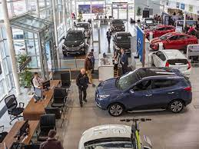
Recommendations For Implementation
Aggregate and hyper tune Model regularly at a Central Office
Set up a website for consumers
Fit with local data as much as possible at dealership
Need to adjust accordingly based on access and amount of data

Slide 9
Thank You For Listening
Questions?

Slide 10
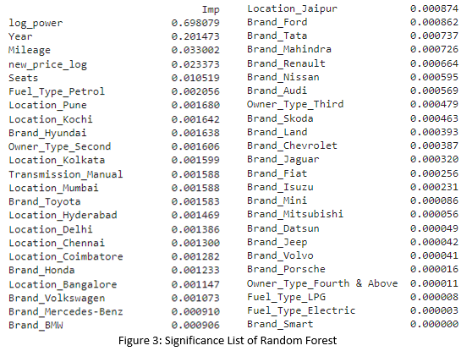
Appendix

Slide 11
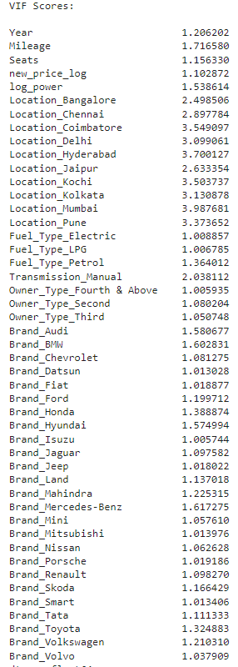
VIF Scores

Slide 12
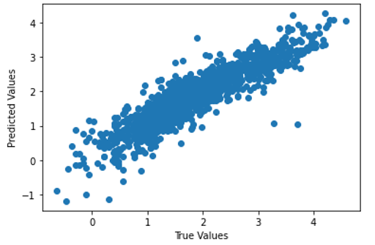
Linear Regression Predicted Vs True Values

Slide 13
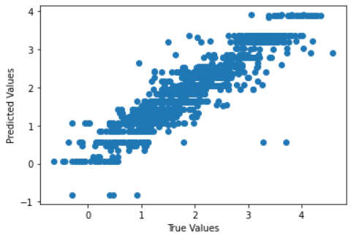
Decision Tree Tuned Predicted vs. True Values

Slide 14
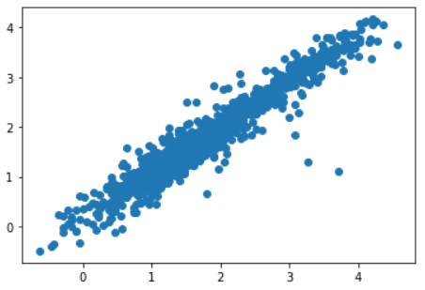

Random Forest Tuned with Imputed Dataset

